Slide 1


Methods
Chris Piech
CS106A, Stanford University
This is Method Man. He is part of the Wu Tang Clan. ☺

Slide 2
Boolean Variable
boolean karelIsAwesome = true;
boolean myBool = 1 < 2;

Slide 3
Boolean Operations
boolean a = true;
boolean b = false;
boolean and = a && b;
boolean or = a || b;
boolean not = !a;

Slide 4
Logical Operators
In order of precedence:
Operator | Description | Example | Result
! | not | !(2 == 3) | true
&& | and | (2 == 3) && (-1 < 5) | false
|| | or | (2 == 3) || (-1 < 5) | true
Cannot "chain" tests as in algebra; use && or || instead
// assume x is 15 // correct version
2 <= x <= 10 2 <= x && x <= 10
true <= 10 true && false
Error! false

Slide 5
boolean food = true;
boolean drinks = true;
boolean isAllowed = !food || drinks;
*know your logical precedence

Slide 6
George Boole
English Mathematician 1815 – 1864
Boole died of being too cool

Slide 7
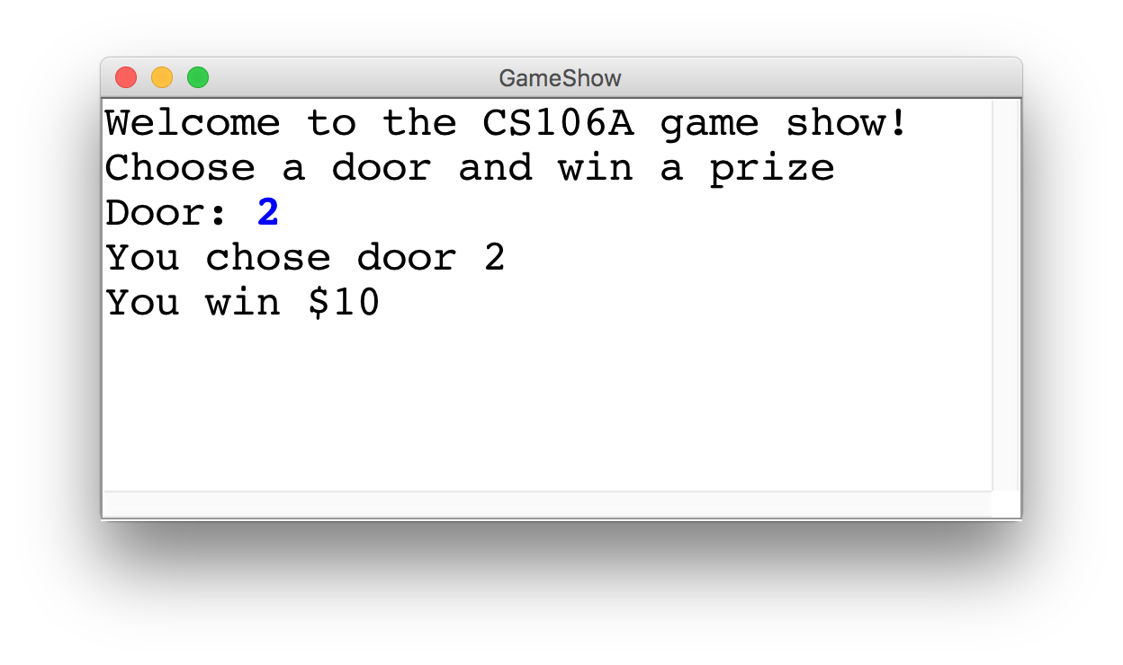
Game Show

Slide 8
Choose a Door
int door = readInt("Door: ");
// while the input is invalid
while(door < 1 || door > 3) {
// tell the user the input was invalid
println("Invalid door!");
// ask for a new input
door = readInt("Door: ");
}
|| or
&& and

Slide 9
The Door Logic
int prize = 4;
if(door == 1) {
prize = 2 + 9 / 10 * 100;
} else if(door == 2) {
boolean locked = prize % 2 != 0;
if(!locked) {
prize += 6;
}
} else if(door == 3) {
prize++;
}

Slide 10
The Door Logic
int prize = 4;
if(door == 1) {
prize = 2 + 9 / 10 * 100;
} else if(door == 2) {
boolean locked = prize % 2 != 0;
if(!locked) {
prize += 6;
}
} else if(door == 3) {
prize++;
}

Slide 11
The Door Logic
int prize = 4;
if(door == 1) {
prize = 2 + 9 / 10 * 100;
} else if(door == 2) {
boolean locked = prize % 2 != 0;
if(!locked) {
prize += 6;
}
} else if(door == 3) {
prize++;
}

Slide 12
The Door Logic
int prize = 4;
if(door == 1) {
prize = 2 + 9 / 10 * 100;
} else if(door == 2) {
boolean locked = prize % 2 != 0;
if(!locked) {
prize += 6;
}
} else if(door == 3) {
prize++;
}

Slide 13
The Door Logic
int prize = 4;
if(door == 1) {
prize = 2 + 9 / 10 * 100;
} else if(door == 2) {
boolean locked = prize % 2 != 0;
if(!locked) {
prize += 6;
}
} else if(door == 3) {
prize++;
}

Slide 14
Civilization advances by extending the number of operations we can perform without thinking about them.
-Alfred North Whitehead

Slide 15

Learn How To:
Write a method that takes in input
Write a method that gives back output
Trace method calls using stacks

Slide 16
Calling Methods
turnRight();
move();
readInt(“Int please! ”);
println(“hello world”);
rect.setFilled(true);
drawRobotFace();
add(rect);
preventGlobalWarming();

Slide 17

Defining a Method
private void turnRight() {
turnLeft();
turnLeft();
turnLeft();
}
Big difference with Java methods:
Java methods can take in data, and can return data!

Slide 18
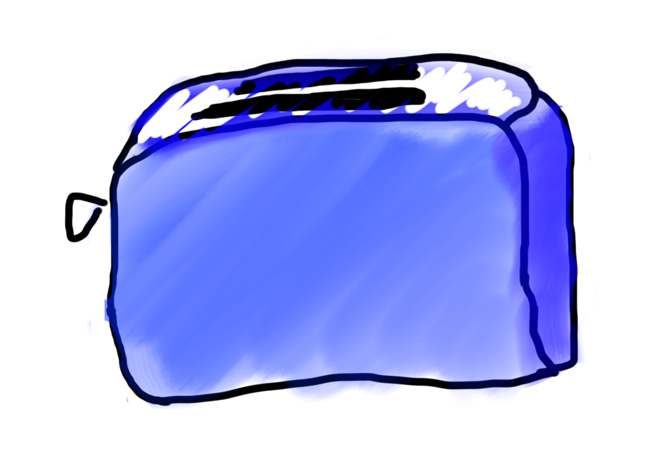
Toasters are Methods
For example:
runToaster
- Thanks Mehran

Slide 19
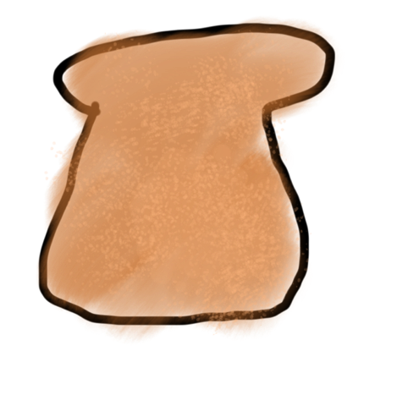
Toasters are Methods
parameter

Slide 20

Toasters are Methods
parameter

Slide 21
Toasters are Methods

Slide 22

Toasters are Methods

Slide 23
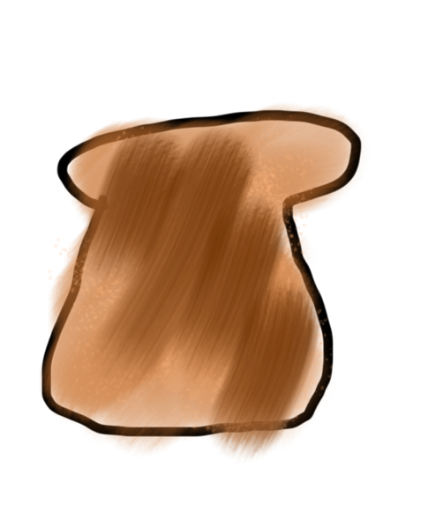
Toasters are Methods
return

Slide 24
Toasters are Methods

Slide 25

Toasters are Methods
* You don’t need a second toaster if you want to toast bagels. Use the same one.

Slide 26
Toasters are Methods

Slide 27

Toasters are Methods

Slide 28
Toasters are Methods

Slide 29
Toasters are Methods

Slide 30
Toasters are Methods

Slide 31
Methods are Like Toasters

Slide 32
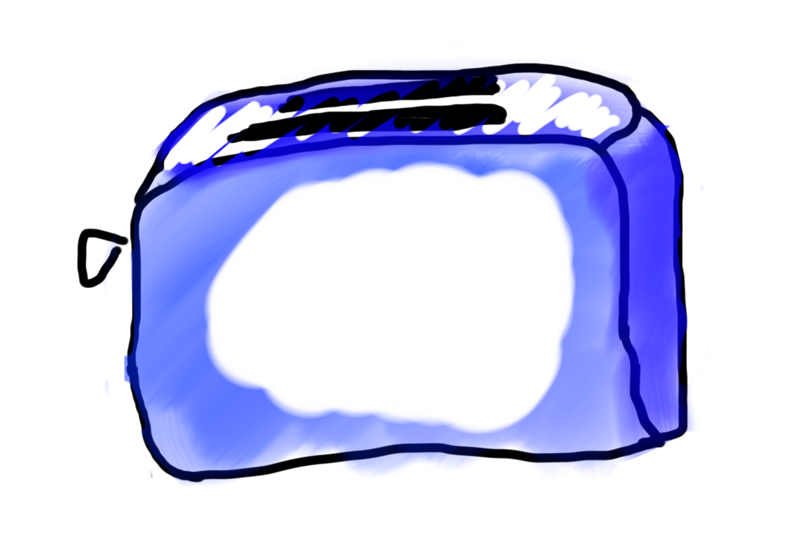
Methods are Like Toasters

Slide 33
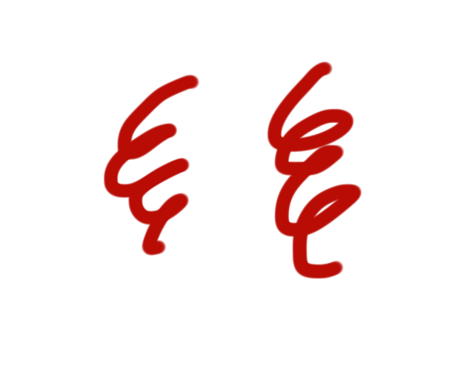
Methods are Like Toasters

Slide 34

Methods are Like Toasters

Slide 35
Methods are Like Toasters
parameter(s)
return

Slide 36
Formally
visibility type nameOfMethod(parameters) {
statements
}
visibility: usually private or public
type: type returned by method (e.g., int , double, etc.)
Can be void to indicate that nothing is returned
parameters: information passed into method

Slide 37
Anatomy of a method
public void run() {
double mid = average(5.0, 10.2);
println(mid);
}
private double average(double a, double b) {
double sum = a + b;
return sum / 2;
}

Slide 38
Anatomy of a method
public void run() {
double mid = average(5.0, 10.2);
println(mid);
}
private double average(double a, double b) {
double sum = a + b;
return sum / 2;
}
method “definition”

Slide 39
Anatomy of a method
public void run() {
double mid = average(5.0, 10.2);
println(mid);
}
private double average(double a, double b) {
double sum = a + b;
return sum / 2;
}
Output expected
Input expected

Slide 40
Anatomy of a method
public void run() {
double mid = average(5.0, 10.2);
println(mid);
}
private double average(double a, double b) {
double sum = a + b;
return sum / 2;
}
Return Type
Parameters

Slide 41
Anatomy of a method
public void run() {
double mid = average(5.0, 10.2);
println(mid);
}
private double average(double a, double b) {
double sum = a + b;
return sum / 2;
}
name

Slide 42
Anatomy of a method
public void run() {
double mid = average(5.0, 10.2);
println(mid);
}
private double average(double a, double b) {
double sum = a + b;
return sum / 2;
}
body

Slide 43
Anatomy of a method
public void run() {
double mid = average(5.0, 10.2);
println(mid);
}
private double average(double a, double b) {
double sum = a + b;
return sum / 2;
}
Ends the method and gives
back a single value

Slide 44
Anatomy of a method
public void run() {
double mid = average(5.0, 10.2);
println(mid);
}
private double average(double a, double b) {
double sum = a + b;
return sum / 2;
}
This statement is necessary because average promised to return a double

Slide 45
Anatomy of a method
public void run() {
double mid = average(5.0, 10.2);
println(mid);
}
private double average(double a, double b) {
double sum = a + b;
return sum / 2;
}
method “call”

Slide 46
Anatomy of a method
public void run() {
double mid = average(5.0, 10.2);
println(mid);
}
private double average(double a, double b) {
double sum = a + b;
return sum / 2;
}
arguments

Slide 47
Anatomy of a method
Return Type
Parameters
public void run() {
double mid = average(5.0, 10.2);
println(mid);
}
private double average(double a, double b) {
double sum = a + b;
return sum / 2;
}

Slide 48
Anatomy of a method
public void run() {
double mid = average(5.0, 10.2);
println(mid);
}
private double average(double a, double b) {
double sum = a + b;
return sum / 2;
}
When a method ends it “returns”

Slide 49

Parameters
Parameters let you provide a method some information when you are calling it.

Slide 50

Learn by Example

Slide 51
Void Example
private void printIntro() {
println("Welcome to class");
println("It's the best part of my day.");
}
public void run() {
printIntro();
}

Slide 52
Void Example
private void printIntro() {
println("Welcome to class");
println("It's the best part of my day.");
}
public void run() {
printIntro();
}

Slide 53
Void Example
private void printIntro() {
println("Welcome to class");
println("It's the best part of my day.");
}
public void run() {
printIntro();
}

Slide 54
Void Example
private void printIntro() {
println("Welcome to class");
println("It's the best part of my day.");
}
public void run() {
printIntro();
}

Slide 55
Void Example
private void printIntro() {
println("Welcome to class");
println("It's the best part of my day.");
}
public void run() {
printIntro();
}

Slide 56
Void Example
private void printIntro() {
println("Welcome to class");
println("It's the best part of my day.");
}
public void run() {
printIntro();
}

Slide 57
Void Example
private void printIntro() {
println("Welcome to class");
println("It's the best part of my day.");
}
public void run() {
printIntro();
}

Slide 58
Void Example
private void printIntro() {
println("Welcome to class");
println("It's the best part of my day.");
}
public void run() {
printIntro();
}

Slide 59
Void Example
private void printIntro() {
println("Welcome to class");
println("It's the best part of my day.");
}
public void run() {
printIntro();
}

Slide 61
Parameter Example
private void printOpinion(int num) {
if(num == 5) {
println(“I love 5!”);
} else {
println(“Whattever”);
}
}
public void run() {
printOpinion(5);
}

Slide 62
Parameter Example
Run memory
private void printOpinion(int num) {
if(num == 5) {
println(“I love 5!”);
} else {
println(“Whattever”);
}
}
No variables
public void run() {
printOpinion(5);
}

Slide 63
Parameter Example
Run memory
private void printOpinion(int num) {
if(num == 5) {
println(“I love 5!”);
} else {
println(“Whattever”);
}
}
No variables
public void run() {
printOpinion(5);
}

Slide 64
Parameter Example
Run memory
printOpinion memory
private void printOpinion(int num) {
if(num == 5) {
println(“I love 5!”);
} else {
println(“Whattever”);
}
}
No variables
public void run() {
printOpinion(5);
}

Slide 65
Parameter Example
Run memory
printOpinion memory
private void printOpinion(int num) {
if(num == 5) {
println(“I love 5!”);
} else {
println(“Whattever”);
}
}
No variables
num
public void run() {
printOpinion(5);
}

Slide 66
Parameter Example
Run memory
printOpinion memory
private void printOpinion(int num) {
if(num == 5) {
println(“I love 5!”);
} else {
println(“Whattever”);
}
}
No variables
num
5
public void run() {
printOpinion(5);
}

Slide 67
Parameter Example
Run memory
printOpinion memory
private void printOpinion(int num) {
if(num == 5) {
println(“I love 5!”);
} else {
println(“Whattever”);
}
}
No variables
num
5
public void run() {
printOpinion(5);
}

Slide 68
Parameter Example
Run memory
printOpinion memory
private void printOpinion(int num) {
if(num == 5) {
println(“I love 5!”);
} else {
println(“Whattever”);
}
}
No variables
num
5
public void run() {
printOpinion(5);
}

Slide 69
Parameter Example
Run memory
printOpinion memory
private void printOpinion(int num) {
if(num == 5) {
println(“I love 5!”);
} else {
println(“Whattever”);
}
}
No variables
num
5
public void run() {
printOpinion(5);
}

Slide 70
Parameter Example
Run memory
private void printOpinion(int num) {
if(num == 5) {
println(“I love 5!”);
} else {
println(“Whattever”);
}
}
No variables
public void run() {
printOpinion(5);
}

Slide 71
Parameter Example
Run memory
private void printOpinion(int num) {
if(num == 5) {
println(“I love 5!”);
} else {
println(“Whattever”);
}
}
No variables
public void run() {
printOpinion(5);
}

Slide 72
Parameter Example
Run memory
private void printOpinion(int num) {
if(num == 5) {
println(“I love 5!”);
} else {
println(“Whattever”);
}
}
No variables
public void run() {
printOpinion(5);
}

Slide 74
Parameter and Return Example
private double metersToCm(double meters) {
return 100 * meters;;
}
public void run() {
double result = metersToCm(5.2);
println(result);
}

Slide 75
Parameter and Return Example
Run memory
private double metersToCm(double meters) {
return 100 * meters;;
}
No variables
public void run() {
double result = metersToCm(5.2);
println(result);
}

Slide 76
Parameter and Return Example
Run memory
private double metersToCm(double meters) {
return 100 * meters;;
}
No variables
public void run() {
double result = metersToCm(5.2);
println(result);
}

Slide 77
Parameter and Return Example
Run memory
meteresToCm memory
private double metersToCm(double meters) {
return 100 * meters;;
}
No variables
public void run() {
double result = metersToCm(5.2);
println(result);
}

Slide 78
Parameter and Return Example
Run memory
meteresToCm memory
private double metersToCm(double meters) {
return 100 * meters;;
}
No variables
meters
5.2
public void run() {
double result = metersToCm(5.2);
println(result);
}

Slide 79
Parameter and Return Example
Run memory
meteresToCm memory
private double metersToCm(double meters) {
return 100 * meters;;
}
No variables
meters
5.2
520.0
public void run() {
double result = metersToCm(5.2);
println(result);
}

Slide 80
Parameter and Return Example
Run memory
private double metersToCm(double meters) {
return 100 * meters;;
}
No variables
520.0
public void run() {
double result = metersToCm(5.2);
println(result);
}

Slide 81
Parameter and Return Example
Run memory
private double metersToCm(double meters) {
return 100 * meters;;
}
result
520.0
520.0
public void run() {
double result = metersToCm(5.2);
println(result);
}

Slide 82
Parameter and Return Example
Run memory
private double metersToCm(double meters) {
return 100 * meters;;
}
result
520.0
public void run() {
double result = metersToCm(5.2);
println(result);
}

Slide 84
Parameter and Return Example
private double metersToCm(double meters) {
return 100 * meters;;
}
public void run() {
println(metersToCm(5.2));
println(metersToCm(9.1));
}

Slide 86
Multiple Return Statements
private int max(int num1, int num2) {
if(num1 >= num2) {
return num1;
}
return num2;
}
public void run() {
int larger = max(5, 1);
}

Slide 87
Multiple Return Statements
Run memory
private int max(int num1, int num2) {
if(num1 >= num2) {
return num1;
}
return num2;
}
No variables
public void run() {
int larger = max(5, 1);
}

Slide 88
Multiple Return Statements
Run memory
private int max(int num1, int num2) {
if(num1 >= num2) {
return num1;
}
return num2;
}
No variables
public void run() {
int larger = max(5, 1);
}

Slide 89
Multiple Return Statements
Run memory
private int max(int num1, int num2) {
if(num1 >= num2) {
return num1;
}
return num2;
}
No variables
public void run() {
int larger = max(5, 1);
}

Slide 90
Multiple Return Statements
Run memory
private int max(int num1, int num2) {
if(num1 >= num2) {
return num1;
}
return num2;
}
No variables
public void run() {
int larger = max(5, 1);
}

Slide 91
Multiple Return Statements
Run memory
max memory
private int max(int num1, int num2) {
if(num1 >= num2) {
return num1;
}
return num2;
}
No variables
num1
num2
public void run() {
int larger = max(5, 1);
}

Slide 92
Multiple Return Statements
Run memory
max memory
private int max(int num1, int num2) {
if(num1 >= num2) {
return num1;
}
return num2;
}
No variables
num1
5
num2
public void run() {
int larger = max(5, 1);
}

Slide 93
Multiple Return Statements
Run memory
max memory
private int max(int num1, int num2) {
if(num1 >= num2) {
return num1;
}
return num2;
}
No variables
num1
5
num2
1
public void run() {
int larger = max(5, 1);
}

Slide 94
Multiple Return Statements
Run memory
max memory
private int max(int num1, int num2) {
if(num1 >= num2) {
return num1;
}
return num2;
}
No variables
num1
5
num2
1
public void run() {
int larger = max(5, 1);
}

Slide 95
Multiple Return Statements
Run memory
max memory
private int max(int num1, int num2) {
if(num1 >= num2) {
return num1;
}
return num2;
}
No variables
num1
5
num2
1
public void run() {
int larger = max(5, 1);
}

Slide 96
Multiple Return Statements
Run memory
max memory
private int max(int num1, int num2) {
if(num1 >= num2) {
return num1;
}
return num2;
}
No variables
num1
5
num2
1
5
public void run() {
int larger = max(5, 1);
}

Slide 97
Multiple Return Statements
Run memory
max memory
private int max(int num1, int num2) {
if(num1 >= num2) {
return num1;
}
return num2;
}
No variables
num1
5
num2
1
5
public void run() {
int larger = max(5, 1);
}

Slide 98
Multiple Return Statements
Run memory
private int max(int num1, int num2) {
if(num1 >= num2) {
return num1;
}
return num2;
}
No variables
5
public void run() {
int larger = max(5, 1);
}

Slide 99
Multiple Return Statements
Run memory
private int max(int num1, int num2) {
if(num1 >= num2) {
return num1;
}
return num2;
}
larger
5
5
public void run() {
int larger = max(5, 1);
}

Slide 100
Multiple Return Statements
Run memory
private int max(int num1, int num2) {
if(num1 >= num2) {
return num1;
}
return num2;
}
larger
5
public void run() {
int larger = max(5, 1);
}

Slide 102
Multiple Return Statements
private int max(int num1, int num2) {
if(num1 >= num2) {
return num1;
}
return num2;
}
public void run() {
int larger = max(5, 1);
}

Slide 103
Multiple Return Statements
private int max(int num1, int num2) {
if(num1 >= num2) {
return num1;
}
return num2;
}
public void run() {
int larger = max(1, 5);
}

Slide 104
Multiple Return Statements
Run memory
private int max(int num1, int num2) {
if(num1 >= num2) {
return num1;
}
return num2;
}
No variables
public void run() {
int larger = max(1, 5);
}

Slide 105
Multiple Return Statements
Run memory
private int max(int num1, int num2) {
if(num1 >= num2) {
return num1;
}
return num2;
}
No variables
public void run() {
int larger = max(1, 5);
}

Slide 106
Multiple Return Statements
Run memory
max memory
private int max(int num1, int num2) {
if(num1 >= num2) {
return num1;
}
return num2;
}
No variables
num1
num2
public void run() {
int larger = max(1, 5);
}

Slide 107
Multiple Return Statements
Run memory
max memory
private int max(int num1, int num2) {
if(num1 >= num2) {
return num1;
}
return num2;
}
No variables
num1
1
num2
5
public void run() {
int larger = max(1, 5);
}

Slide 108
Multiple Return Statements
Run memory
max memory
private int max(int num1, int num2) {
if(num1 >= num2) {
return num1;
}
return num2;
}
No variables
num1
1
num2
5
public void run() {
int larger = max(1, 5);
}

Slide 109
Multiple Return Statements
Run memory
max memory
private int max(int num1, int num2) {
if(num1 >= num2) {
return num1;
}
return num2;
}
No variables
num1
1
num2
5
5
public void run() {
int larger = max(1, 5);
}

Slide 110
Multiple Return Statements
Run memory
private int max(int num1, int num2) {
if(num1 >= num2) {
return num1;
}
return num2;
}
No variables
5
public void run() {
int larger = max(1, 5);
}

Slide 111
Multiple Return Statements
Run memory
private int max(int num1, int num2) {
if(num1 >= num2) {
return num1;
}
return num2;
}
larger
5
5
public void run() {
int larger = max(1, 5);
}

Slide 112
Multiple Return Statements
Run memory
private int max(int num1, int num2) {
if(num1 >= num2) {
return num1;
}
return num2;
}
larger
5
public void run() {
int larger = max(1, 5);
}

Slide 114
Method for Weight on Moon
* Your weight on the moon is 16.5% your weight on the earth

Slide 115
Passing in Colors

Slide 116
Flags
private void drawColombiasFlag() {
// Call drawStripe three times
// with different inputs each time
drawStripe(Color.YELLOW, 0, 0.5); drawStripe(Color.BLUE, 0.5, 0.75); drawStripe(Color.RED, 0.75, 1.0);
}
// Define drawStripe
// drawStripe needs three inputs (which come as variables)
// First a color, then a start (in screen percent) and end y.
private void drawStripe(Color color, double yStart, double yEnd) {
double yStartPx = getHeight() * yStart;
double yEndPx = getHeight() * yEnd;
GRect rect = new GRect(getWidth(), yEndPx - yStartPx);
rect.setColor(color);
rect.setFilled(true);
add(rect, 0, yStartPx);
}
method “definition”

Slide 117
Flags
private void drawColombiasFlag() {
// Call drawStripe three times
// with different inputs each time
drawStripe(Color.YELLOW, 0, 0.5); drawStripe(Color.BLUE, 0.5, 0.75); drawStripe(Color.RED, 0.75, 1.0);
}
Takes three inputs: (1) a color, (2) a fraction start, (3) a fraction end
// Define drawStripe
// drawStripe needs three inputs (which come as variables)
// First a color, then a start (in screen percent) and end y.
private void drawStripe(Color color, double yStart, double yEnd) {
double yStartPx = getHeight() * yStart;
double yEndPx = getHeight() * yEnd;
GRect rect = new GRect(getWidth(), yEndPx - yStartPx);
rect.setColor(color);
rect.setFilled(true);
add(rect, 0, yStartPx);
}

Slide 118
Flags
private void drawColombiasFlag() {
// Call drawStripe three times
// with different inputs each time
drawStripe(Color.YELLOW, 0, 0.5); drawStripe(Color.BLUE, 0.5, 0.75); drawStripe(Color.RED, 0.75, 1.0);
}
Thus, every time the method is called, three inputs must be given!
// Define drawStripe
// drawStripe needs three inputs (which come as variables)
// First a color, then a start (in screen percent) and end y.
private void drawStripe(Color color, double yStart, double yEnd) {
double yStartPx = getHeight() * yStart;
double yEndPx = getHeight() * yEnd;
GRect rect = new GRect(getWidth(), yEndPx - yStartPx);
rect.setColor(color);
rect.setFilled(true);
add(rect, 0, yStartPx);
}

Slide 119
Flags
private void drawColombiasFlag() {
// Call drawStripe three times
// with different inputs each time
drawStripe(Color.YELLOW, 0, 0.5); drawStripe(Color.BLUE, 0.5, 0.75); drawStripe(Color.RED, 0.75, 1.0);
}
Thus, every time the method is called, three inputs must be given!
The method receives the first input in a box (aka as a variable), with the name color
// Define drawStripe
// drawStripe needs three inputs (which come as variables)
// First a color, then a start (in screen percent) and end y.
private void drawStripe(Color color, double yStart, double yEnd) {
double yStartPx = getHeight() * yStart;
double yEndPx = getHeight() * yEnd;
GRect rect = new GRect(getWidth(), yEndPx - yStartPx);
rect.setColor(color);
rect.setFilled(true);
add(rect, 0, yStartPx);
}

Slide 120
A Full Program
public class FactorialExample extends ConsoleProgram {
private static final int MAX_NUM = 4;
public void run() {
for(int i = 0; i < MAX_NUM; i++) {
println(i + "! = " + factorial(i));
}
}
private int factorial(int n) {
int result = 1;
for (int i = 1; i <= n; i++) {
result *= i;
}
return result;
}
}

Slide 121
A Full Program
public class FactorialExample extends ConsoleProgram {
private static final int MAX_NUM = 4;
public void run() {
for(int i = 0; i < MAX_NUM; i++) {
println(i + "! = " + factorial(i));
}
}
private int factorial(int n) {
int result = 1;
for (int i = 1; i <= n; i++) {
result *= i;
}
return result;
}
}

Slide 122
Understand the Mechanism

Slide 123
public void run() {
for(int i = 0; i < MAX_NUM; i++) {
println(i + "! = " + factorial(i));
}
}
i

Slide 124
public void run() {
for(int i = 0; i < MAX_NUM; i++) {
println(i + "! = " + factorial(i));
}
}
i
0

Slide 125
public void run() {
for(int i = 0; i < MAX_NUM; i++) {
println(i + "! = " + factorial(i));
}
}
i
0

Slide 126
public void run() {
for(int i = 0; i < MAX_NUM; i++) {
println(i + "! = " + factorial(i));
}
}
i
0

Slide 127
public void run() {
for(int i = 0; i < MAX_NUM; i++) {
println(i + "! = " + factorial(i));
}
}
i
0

Slide 128
public void run() {
for(int i = 0; i < MAX_NUM; i++) {
println(i + "! = " + factorial(i));
}
}
private int factorial(int n) {
int result = 1;
for (int i = 1; i <= n; i++) {
result *= i;
}
return result;
}
0
i
n
0
result
i

Slide 129
public void run() {
for(int i = 0; i < MAX_NUM; i++) {
println(i + "! = " + factorial(i));
}
}
private int factorial(int n) {
int result = 1;
for (int i = 1; i <= n; i++) {
result *= i;
}
return result;
}
0
i
n
0
1
result
i

Slide 130
public void run() {
for(int i = 0; i < MAX_NUM; i++) {
println(i + "! = " + factorial(i));
}
}
private int factorial(int n) {
int result = 1;
for (int i = 1; i <= n; i++) {
result *= i;
}
return result;
}
0
i
n
0
1
1
result
i

Slide 131
public void run() {
for(int i = 0; i < MAX_NUM; i++) {
println(i + "! = " + factorial(i));
}
}
private int factorial(int n) {
int result = 1;
for (int i = 1; i <= n; i++) {
result *= i;
}
return result;
}
0
i
n
0
1
1
result
i

Slide 132
public void run() {
for(int i = 0; i < MAX_NUM; i++) {
println(i + "! = " + factorial(i));
}
}
private int factorial(int n) {
int result = 1;
for (int i = 1; i <= n; i++) {
result *= i;
}
return result;
}
0
i
n
0
1
1
result
i

Slide 133
public void run() {
for(int i = 0; i < MAX_NUM; i++) {
println(i + "! = " + factorial(i));
}
}
1
i
0

Slide 134
public void run() {
for(int i = 0; i < MAX_NUM; i++) {
println(i + "! = " + factorial(i));
}
}
1
i
0
0! = 1

Slide 135
public void run() {
for(int i = 0; i < MAX_NUM; i++) {
println(i + "! = " + factorial(i));
}
}
i
1
0! = 1

Slide 136
public void run() {
for(int i = 0; i < MAX_NUM; i++) {
println(i + "! = " + factorial(i));
}
}
i
1
0! = 1

Slide 137
public void run() {
for(int i = 0; i < MAX_NUM; i++) {
println(i + "! = " + factorial(i));
}
}
i
1
0! = 1

Slide 138
public void run() {
for(int i = 0; i < MAX_NUM; i++) {
println(i + "! = " + factorial(i));
}
}
i
1
0! = 1

Slide 139
public void run() {
for(int i = 0; i < MAX_NUM; i++) {
println(i + "! = " + factorial(i));
}
}
private int factorial(int n) {
int result = 1;
for (int i = 1; i <= n; i++) {
result *= i;
}
return result;
}
0
i
n
1
result
i
0! = 1

Slide 140
public void run() {
for(int i = 0; i < MAX_NUM; i++) {
println(i + "! = " + factorial(i));
}
}
private int factorial(int n) {
int result = 1;
for (int i = 1; i <= n; i++) {
result *= i;
}
return result;
}
0
i
n
1
1
result
i
0! = 1

Slide 141
public void run() {
for(int i = 0; i < MAX_NUM; i++) {
println(i + "! = " + factorial(i));
}
}
private int factorial(int n) {
int result = 1;
for (int i = 1; i <= n; i++) {
result *= i;
}
return result;
}
0
i
n
1
1
1
result
i
0! = 1

Slide 142
public void run() {
for(int i = 0; i < MAX_NUM; i++) {
println(i + "! = " + factorial(i));
}
}
private int factorial(int n) {
int result = 1;
for (int i = 1; i <= n; i++) {
result *= i;
}
return result;
}
0
i
n
1
1
1
result
i
0! = 1

Slide 143
public void run() {
for(int i = 0; i < MAX_NUM; i++) {
println(i + "! = " + factorial(i));
}
}
private int factorial(int n) {
int result = 1;
for (int i = 1; i <= n; i++) {
result *= i;
}
return result;
}
0
i
n
1
1
1
result
i
0! = 1

Slide 144
public void run() {
for(int i = 0; i < MAX_NUM; i++) {
println(i + "! = " + factorial(i));
}
}
private int factorial(int n) {
int result = 1;
for (int i = 1; i <= n; i++) {
result *= i;
}
return result;
}
0
i
n
1
1
2
result
i
0! = 1

Slide 145
public void run() {
for(int i = 0; i < MAX_NUM; i++) {
println(i + "! = " + factorial(i));
}
}
private int factorial(int n) {
int result = 1;
for (int i = 1; i <= n; i++) {
result *= i;
}
return result;
}
0
i
n
1
1
2
result
i
0! = 1

Slide 146
public void run() {
for(int i = 0; i < MAX_NUM; i++) {
println(i + "! = " + factorial(i));
}
}
private int factorial(int n) {
int result = 1;
for (int i = 1; i <= n; i++) {
result *= i;
}
return result;
}
0
i
n
1
1
2
result
i
0! = 1

Slide 147
public void run() {
for(int i = 0; i < MAX_NUM; i++) {
println(i + "! = " + factorial(i));
}
}
1
i
1
0! = 1

Slide 148
public void run() {
for(int i = 0; i < MAX_NUM; i++) {
println(i + "! = " + factorial(i));
}
}
1
i
1
0! = 1
1! = 1

Slide 149
public void run() {
for(int i = 0; i < MAX_NUM; i++) {
println(i + "! = " + factorial(i));
}
}
i
2
0! = 1
1! = 1

Slide 150
public void run() {
for(int i = 0; i < MAX_NUM; i++) {
println(i + "! = " + factorial(i));
}
}
i
2
0! = 1
1! = 1

Slide 151
public void run() {
for(int i = 0; i < MAX_NUM; i++) {
println(i + "! = " + factorial(i));
}
}
i
2
0! = 1
1! = 1

Slide 152
public void run() {
for(int i = 0; i < MAX_NUM; i++) {
println(i + "! = " + factorial(i));
}
}
i
2
0! = 1
1! = 1

Slide 153
public void run() {
for(int i = 0; i < MAX_NUM; i++) {
println(i + "! = " + factorial(i));
}
}
2
i
2
0! = 1
1! = 1

Slide 154
public void run() {
for(int i = 0; i < MAX_NUM; i++) {
println(i + "! = " + factorial(i));
}
}
2
i
2
0! = 1
1! = 1
2! = 2

Slide 155
public void run() {
for(int i = 0; i < MAX_NUM; i++) {
println(i + "! = " + factorial(i));
}
}
i
3
0! = 1
1! = 1
2! = 2

Slide 156
public void run() {
for(int i = 0; i < MAX_NUM; i++) {
println(i + "! = " + factorial(i));
}
}
i
3
0! = 1
1! = 1
2! = 2

Slide 157
public void run() {
for(int i = 0; i < MAX_NUM; i++) {
println(i + "! = " + factorial(i));
}
}
i
3
0! = 1
1! = 1
2! = 2

Slide 158
public void run() {
for(int i = 0; i < MAX_NUM; i++) {
println(i + "! = " + factorial(i));
}
}
i
3
0! = 1
1! = 1
2! = 2

Slide 159
public void run() {
for(int i = 0; i < MAX_NUM; i++) {
println(i + "! = " + factorial(i));
}
}
6
i
3
0! = 1
1! = 1
2! = 2

Slide 160
public void run() {
for(int i = 0; i < MAX_NUM; i++) {
println(i + "! = " + factorial(i));
}
}
6
i
3
0! = 1
1! = 1
2! = 2
3! = 6

Slide 161
public void run() {
for(int i = 0; i < MAX_NUM; i++) {
println(i + "! = " + factorial(i));
}
}
i
4
0! = 1
1! = 1
2! = 2
3! = 6

Slide 162
public void run() {
for(int i = 0; i < MAX_NUM; i++) {
println(i + "! = " + factorial(i));
}
}
i
4
0! = 1
1! = 1
2! = 2
3! = 6

Slide 163
Parameters
Every time a method is called, new memory is created for the call.

Slide 164
Bad Times With Methods
// NOTE: This program is buggy!!
private void addFive(int x) {
x += 5;
}
public void run() {
int x = 3;
addFive(x);
println("x = " + x);
}
Let’s “trace” this program on the board

Slide 165
Good Times With Methods
// NOTE: This program is feeling just fine...
private int addFive(int x) {
x += 5;
return x;
}
public void run() {
int x = 3;
x = addFive(x);
println("x = " + x);
}

Slide 166
For primitives: Variables are not passed when you use parameters. Values are passed

Slide 167
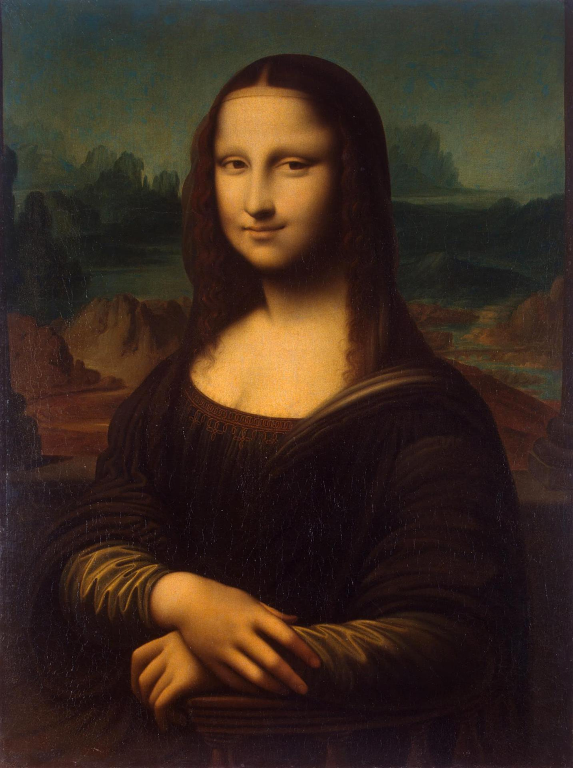
Pass by “Value”
- Thanks Mehran

Slide 168
More Examples

Slide 169
Changed Name
private void run() {
int num = 5;
cow(num);
}
private void cow(int grass) {
println(grass);
}

Slide 170
Same Variable Name
private void run() {
int num = 5;
cow();
println(num);
}
private void cow() {
int num = 10;
println(num);
}

Slide 171

No Methods in Methods
private void run() {
println(“hello world”);
private void sayGoodbye() {
println(“goodbye!”);
}
}
Illegal modifier for parameter goodbye, only final is permitted
Huh?!?

Slide 172
No Methods in Methods
private void run() {
println(“hello world”);
sayGoodbye();
}
private void sayGoodbye() {
println(“goodbye!”);
}

Slide 173
Methods Called on Objects
GRect rect = new GRect(20, 20);
rect.setColor(Color.Blue);
receiver
* We will talk about how to define these later in the class

Slide 174
Learn How To:
Write a method that takes in input
Write a method that gives back output
Trace method calls using stacks

Slide 175
Remember Booleans?

Slide 176
Boolean Variable
boolean karelIsAwesome = true;
boolean myBool = 1 < 2;

Slide 177
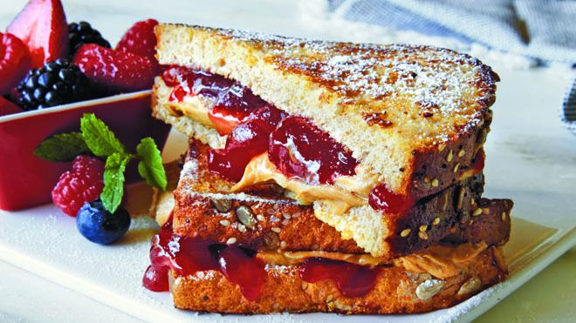

Slide 178
Is Square
private void run() {
for(int i = 1; i <= 100; i++) {
if(isSquare(i)) {
println(i);
}
}
}

Slide 179
Boolean Return
public void run() {
for(int i = 1; i <= 100; i++) {
if(isSquare(i)) {
println(i);
}
}
}
private boolean isSquare(int x) {
double root = Math.sqrt(x);
if(root == Math.floor(root)) {
return true;
} else {
return false;
}
}

Slide 180
Boolean Return
public void run() {
for(int i = 1; i <= 100; i++) {
if(isSquare(i)) {
println(i);
}
}
}
private boolean isSquare(int x) {
double root = Math.sqrt(x);
return root == Math.floor(root);
}

Slide 181
Boolean Return
public void run() {
for(int i = 1; i <= 100; i++) {
if(isSquare(i)) {
println(i);
}
}
}
private boolean isSquare(int x) {
double root = Math.sqrt(x);
return root == (int)root;
}

Slide 182

Extra Exercise
Greek mathematicians took a special interest in numbers that are equal to the sum of their proper divisors (a proper divisor of n is any divisor less than n itself). They called such numbers perfect numbers. For example, 6 is a perfect number because it is the sum of 1, 2, and 3, which are the integers less than 6 that divide evenly into 6. Similarly, 28 is a perfect number because it is the sum of 1, 2, 4, 7, and 14.
Design and implement a Java program that finds all the perfect numbers between two limits. For example, if the limits are 1 and 10000, the output should look like this:
FindPerfect
The perfect numbers between 1 and 10000 are:
6
28
496
8128

